Slide 1
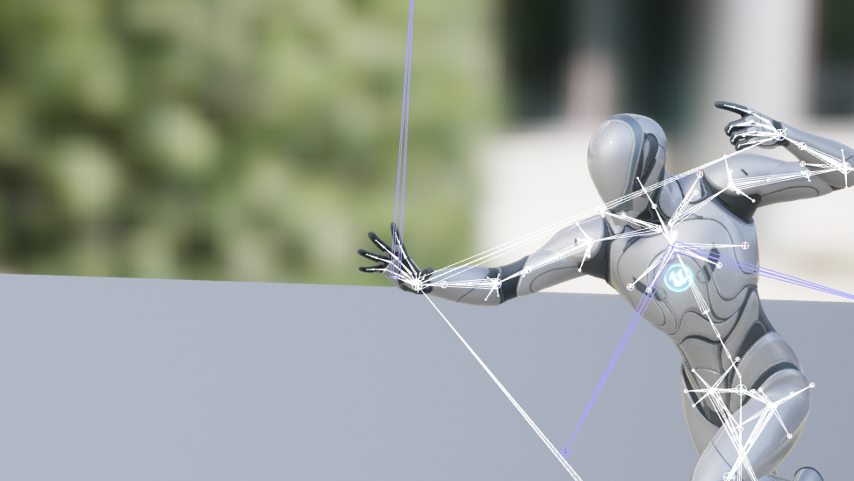
UNREAL NEURAL
Runtime Animation Generator
Unreal Engine Plugin

Slide 2
Contents
Pipeline Overview: Working Version
Data Processing Progress
Unreal Engine Progress
Pipeline Overview: Final Goal
Notes:
Look through current pipeline of our project

Slide 3
Pipeline Overview
Text Input
Model
Motion Data
Conv
FBX Data
Python
Unreal Engine
Working Version
FBX
Data
Assimp
Motion
Data
Runtime
Importer
Animation
Sequence
Applied!
Animation
State
Retarget
ing
Notes:
We have worked on the model part and unreal part separately.
Python part
Unre

Slide 4
Pipeline Overview
Text Input
Model
Motion Data
Conv
FBX Data
Python
Unreal Engine
Working Version
FBX
Data
Assimp
Motion
Data
Runtime
Importer
Animation
Sequence
Applied!
Animation
State
Retarget
ing
Notes:
I’m going to make a presentation about these two parts.

Slide 5
Adjusting Model Output
For Unreal Engine
Data
Processing
Progress

Slide 6
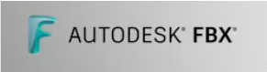
Model Output
SMPL Format
Data
Processing
Progress
FBX File
For Unreal Engine
Notes:
In last ppt we explained about formatting model output using SMPL

Slide 7
Model Output
SMPL Format
Data
Processing
Progress
FBX File
For Unreal Engine
Notes:
This week we convert smpl format data to fbx file for unreal engine.
Fbx sdk is used to parse SMPL data to fbx
By Fbxsdk we can construct each node of skeleton and each vertex of meshes

Slide 8
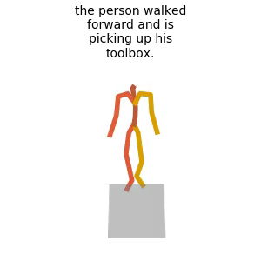
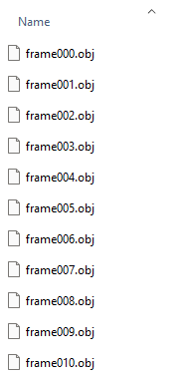
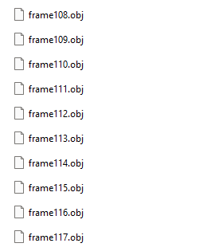
Model Result FBX File
…
Notes:
This is conversion output
Input text
Result output
This image is generated from web visualizer

Slide 9
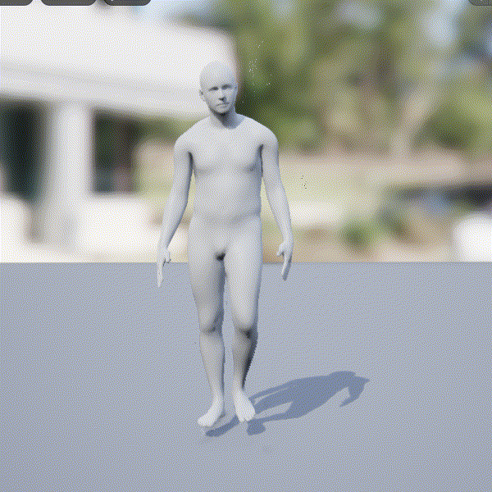
In Unreal Engine
Notes:
We can import the fbx but have some minor problems.
Frame rate is too fast
Overall position is not correctly applied. It doesn’t go down.
We didn’t check the data but we are guessing

Slide 10
Runtime Animation Import
Unreal
Engine
Progress
Notes:
Let’s talk about progress in unreal engine part.
We implemented runtime animation importing functionality

Slide 11
Runtime Animation Import
Parsing Motion Data (FBX)
Preparing Skeleton & Mesh
Assimp(Open Asset Import Library)
Target Data
Frame rate
Animation Length
Bones
Name
Rotation
Position
Scaling
Imported beforehand
Same bone hierarchy as the target data.
Notes:
Two part
Parsing motion data using fbx. We have to iterate every nodes and frames to get data.
Target data. Iterate every tick.
On the other hand
2. Prepare skeleton and mesh for matching

Slide 12
Runtime Animation Import
Parsed
Animation Data
Prepared
Skeleton & Mesh
UAnimSequence*
Notes:
Combining two data we can create UAnimSequence, which is a animation sequence class in unreal engine
Let me show you visual example

Slide 13
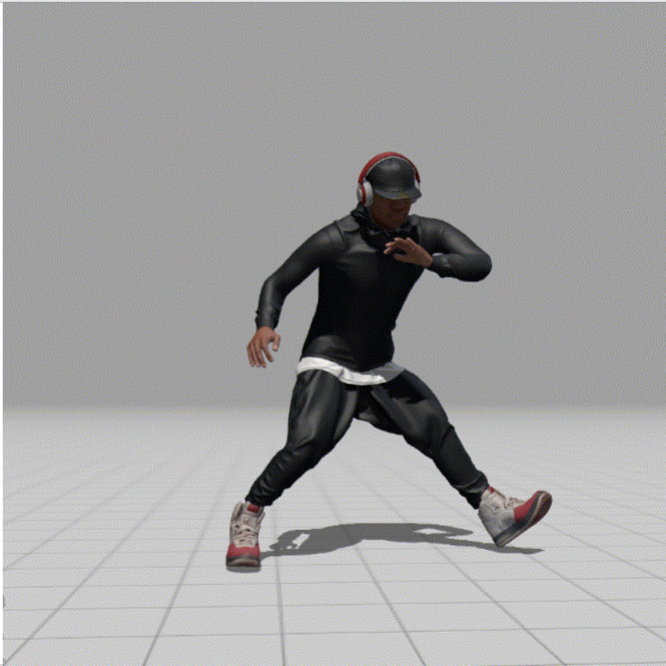
Target Animation
Notes:
It’s motion data file in fbx format which is not imported in unreal engine.

Slide 14
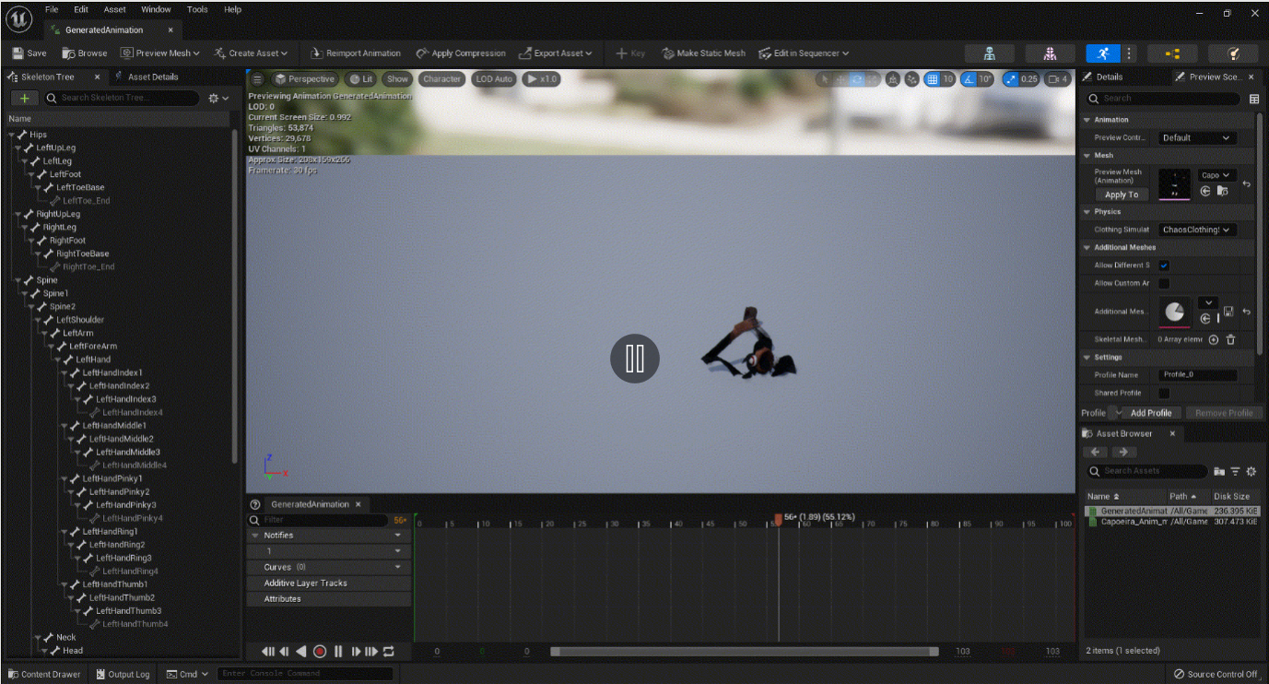
Notes:
I just set it to import a fbx right after play

Slide 15
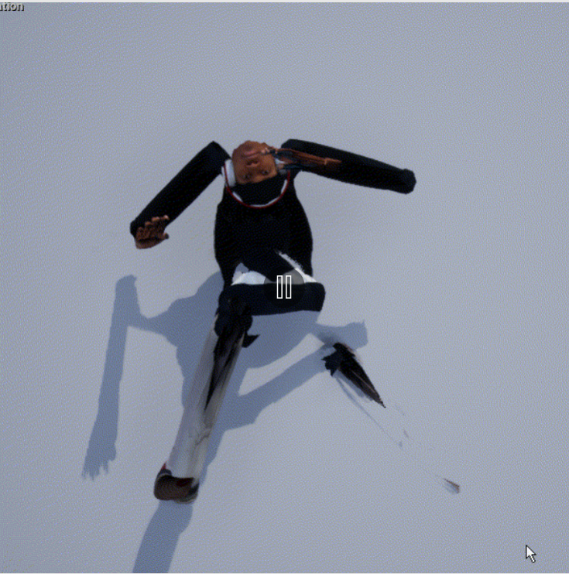
Imported Animaion
Notes:
It turns out the axes model used are different from unreal engine

Slide 16
Pipeline Overview
Text Input
Model
Motion Data
Conv
FBX Data
Python
Unreal Engine
Working Version
FBX
Data
Assimp
Motion
Data
Runtime
Importer
Animation
Sequence
Applied!
Animation
State
Retargeting
Notes:
This is current pipeline we completed. But it’s separated and need to combine them.
We were truggling to setting pipeline for combining them. Python codes needs lots of environment dependencies.
Even if we run onnx model in c++, we have to re-implement the conversion processes from python to c++, with different libraries.
But we found most reasonable solution.

Slide 17
Unreal Engine
Text Input
ONNX
Model
Motion Data
Conv
Pipeline Overview
Animation
Sequence
Runtime
Importer
Motion
Data
Final Goal
Retargeting
Animation
State
Applied!
Notes:
It is not using fbx at all.
We mentioned fbx a lot. Because it’s most common file format.
I thought it would be easy to import motion data if we use fbx format because it’s most common file format in unreal engine,
But turns out, I had to manually parse each node data from fbx format if we are going to import it in runtime.
And I already did it when implementing runtime import functionality. So it will be easy to parse
By using onnx model we can combine model side and unreal engine.

Slide 18
To Do Next Week
Train Model (Augmentation)
Fix Position & Axes Issues
Export Model for Unreal Engine(ONNX)

Slide 19
THANK YOU
UNREAL NEURAL

